Slide 1
EcoSmartHydro
+ Groundwater Recharge
Designing a combined water+energy solution for California
CONFIDENTIAL, Natel Energy, 2015

Slide 2
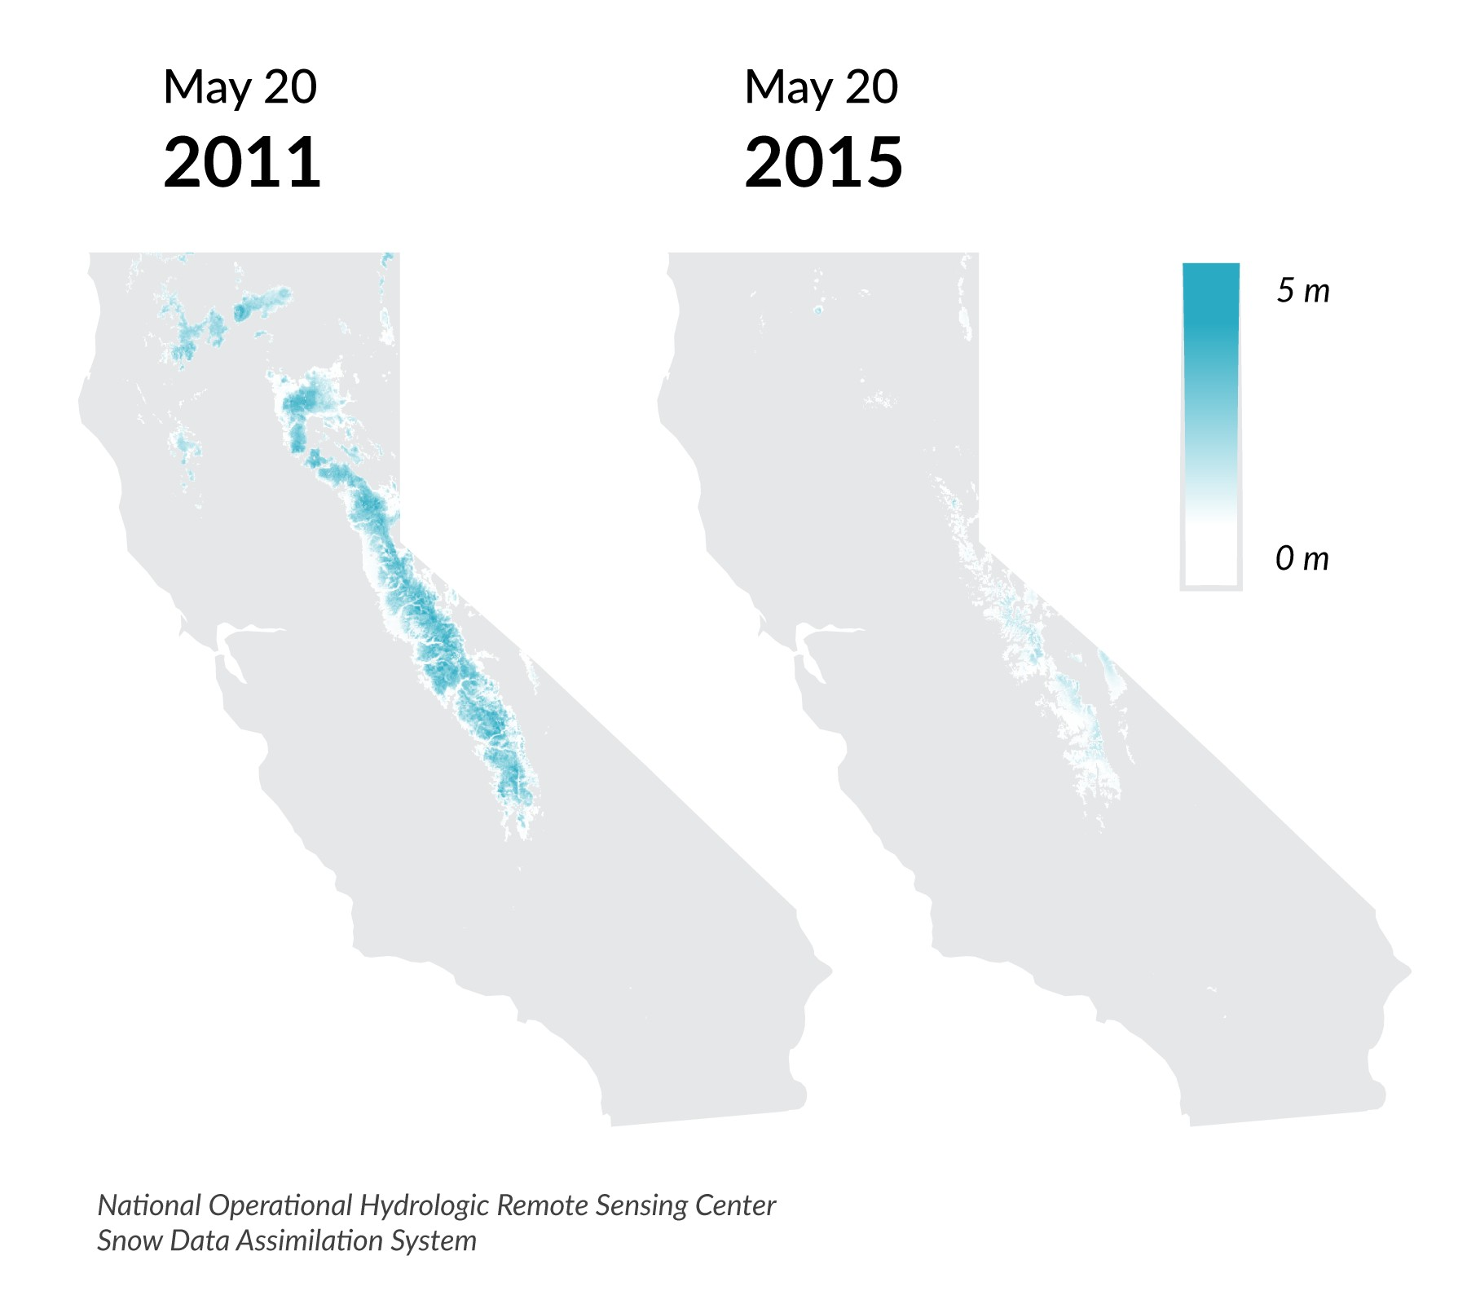
The California drought cost the state $2.2 billion in 2014
$1.5 billion in direct costs to agriculture +
the loss of 17,000 seasonal and part-time jobs.*
Climate change is increasing the frequency and severity of droughts in California, and shifting precipitation from snow to rain.
To mitigate climate change, California is seeking to shift electricity generation to renewable energy sources.
Snow Depth
CONFIDENTIAL, Natel Energy, 2015
*University of California, Davis: Economic Analysis of the 2014 Drought for California Agriculture

Slide 3
Drought + climate change → unsustainable draw on
groundwater
The city of Fresno spent $9 million on electricity to pump groundwater in 2011 in response to decreasing surface water availability.*
As a result of these pumping trends, USGS has calculated that nearly 80 million acre-feet of groundwater have been lost since 1962 levels.*
The DWR has recorded that ~40% of recharge wells have detected a decrease in groundwater levels of 2.5 feet or more. This is resulting in land subsidence that can be as great as 2 inches a month in 2015.
To supplement lost surface water, groundwater withdrawals have increased, resulting in a net annual loss in groundwater of 1.5 million acre feet in 2014.
*California Department of Water Resources
Change in Groundwater Levels
CONFIDENTIAL, Natel Energy, 2015

Slide 4
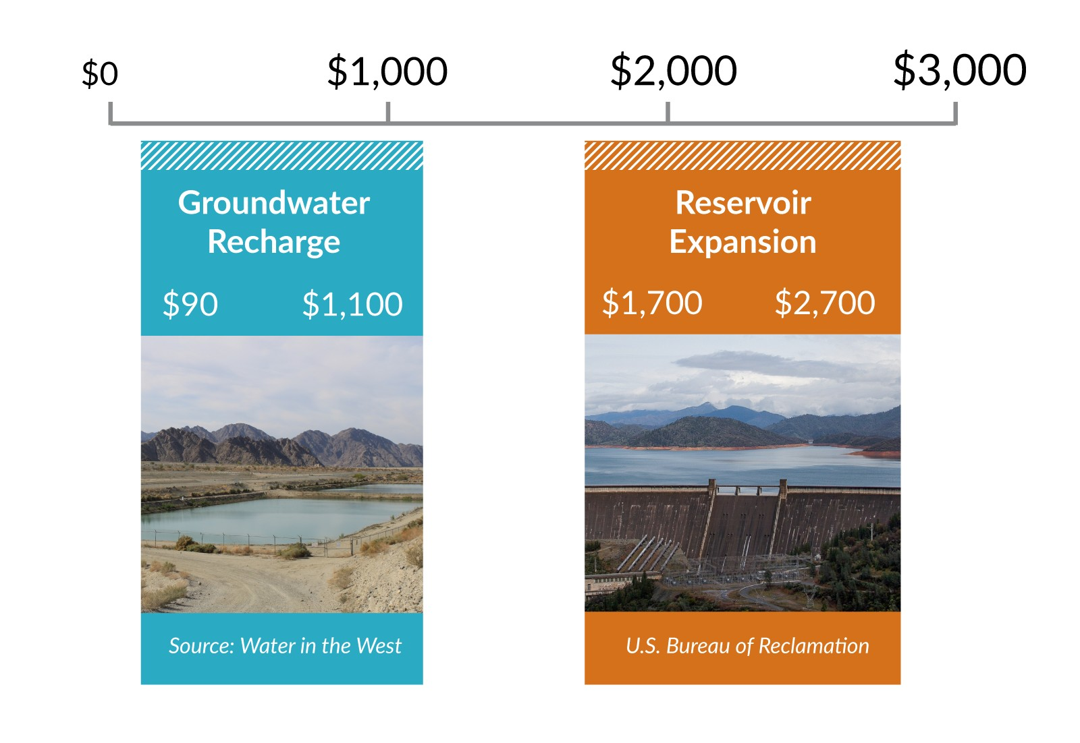
Groundwater recharge: a sustainable solution
Capturing excess runoff and recharging groundwater is essential as groundwater pumping rates skyrocket in dry times: groundwater recharge efforts are significantly less expensive, more efficient, and have more potential storage capacity than continued surface reservoir expansion.
New Water Storage Capacity (cost / acre-foot)
Making up for just the 1.5 million acre-feet lost in 2014 through surface reservoir expansion would cost between $2550 million to $4050 million.** In contrast, managed groundwater recharge efforts would cost between $135 million and $1650 million.
CONFIDENTIAL, Natel Energy, 2015
**Understanding California’s Groundwater: Water in the West at Stanford. The Hidden Costs of Groundwater Overdraft

Slide 5
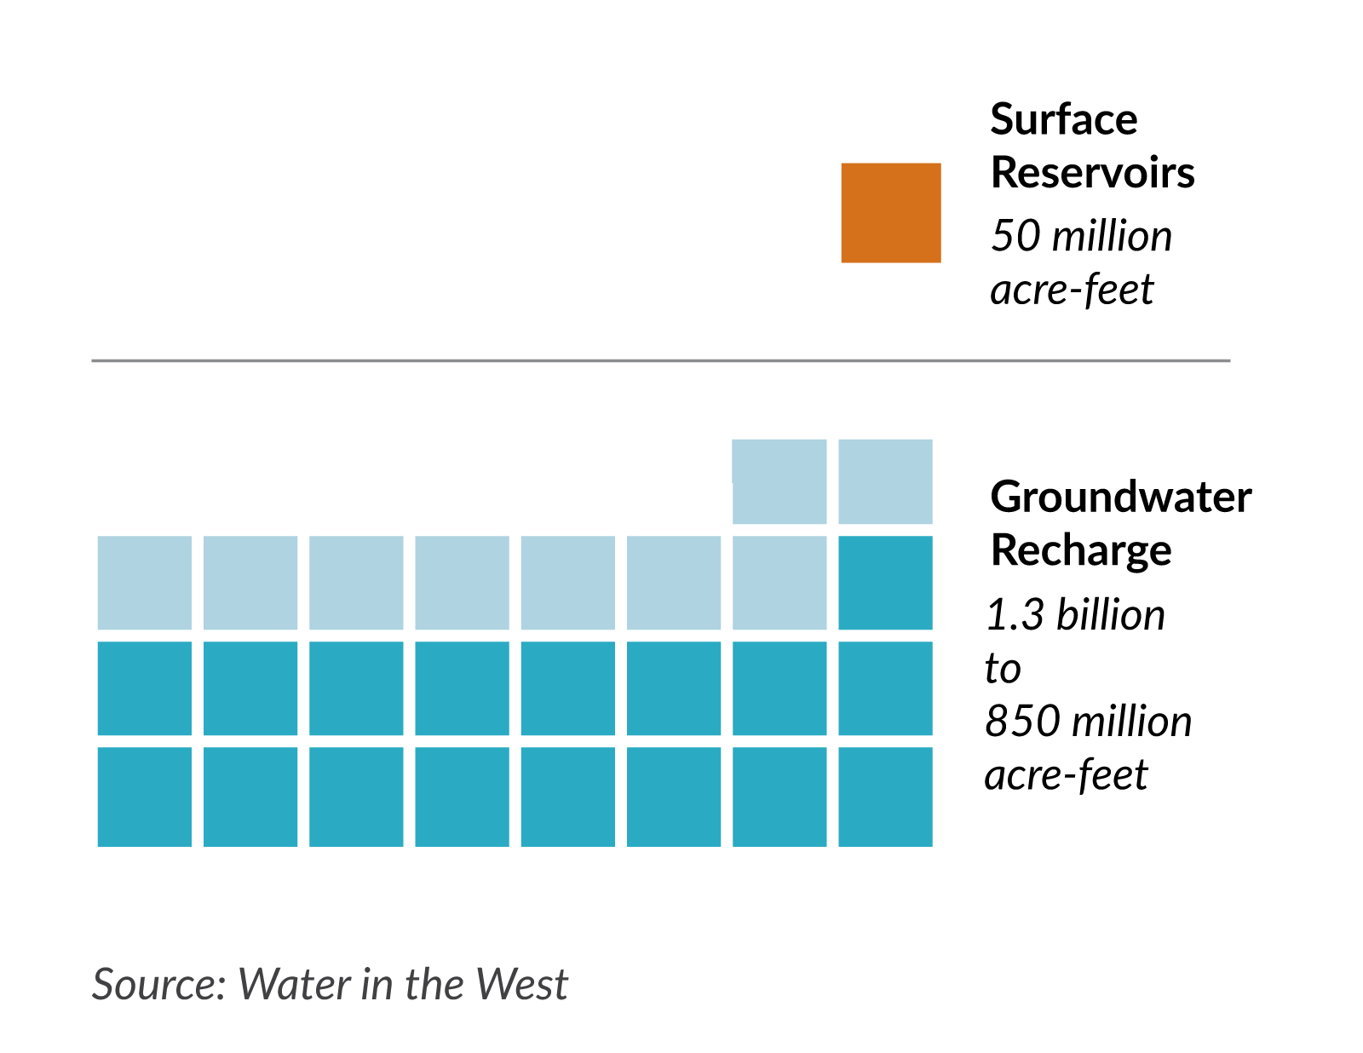
Groundwater recharge: a scaleable solution
Far greater storage capacity exists in groundwater aquifers than in available surface storage - the California Department of Water Resources estimates there is 1 billion acre-feet of total storage capacity in CA’s 515 groundwater basins, vs. less than 50 million acre-feet from all major reservoirs.
California currently oversees an extensive surface water storage system, capable of storing about half the average annual statewide runoff.* Most surface storage is located near the source, far from major farming and urban centers. However, the state’s capacity for storing water in aquifers is far greater, and much of this capacity is nearer to water users.**
Existing Water Storage Capacity
Surface reservoirs can fill quickly and release water fairly quickly, making them flexible for water supply and flood management. But expanding surface storage capacity is costly and ecologically damaging. Groundwater storage capacity is already abundant, but aquifers recharge and empty far more slowly than surface reservoirs, making them more suitable for long-term or dry-year storage.
*Runoff=The remaining water after precipitation that does not evaporate, and that flows downhill into streams and groundwater basins, and becomes available for management and use

Slide 6
What if...
...we built a project that could deliver:
1.5 million acre-feet groundwater recharge annually 500 MW dispatchable hydro able to provide 1,000 MWh of firming power daily
ALL while investing in water infrastructure that will increase climate change resiliency in California and help meet the state’s proposed goal of 50% utility power from
renewable energy by 2030?

Slide 7
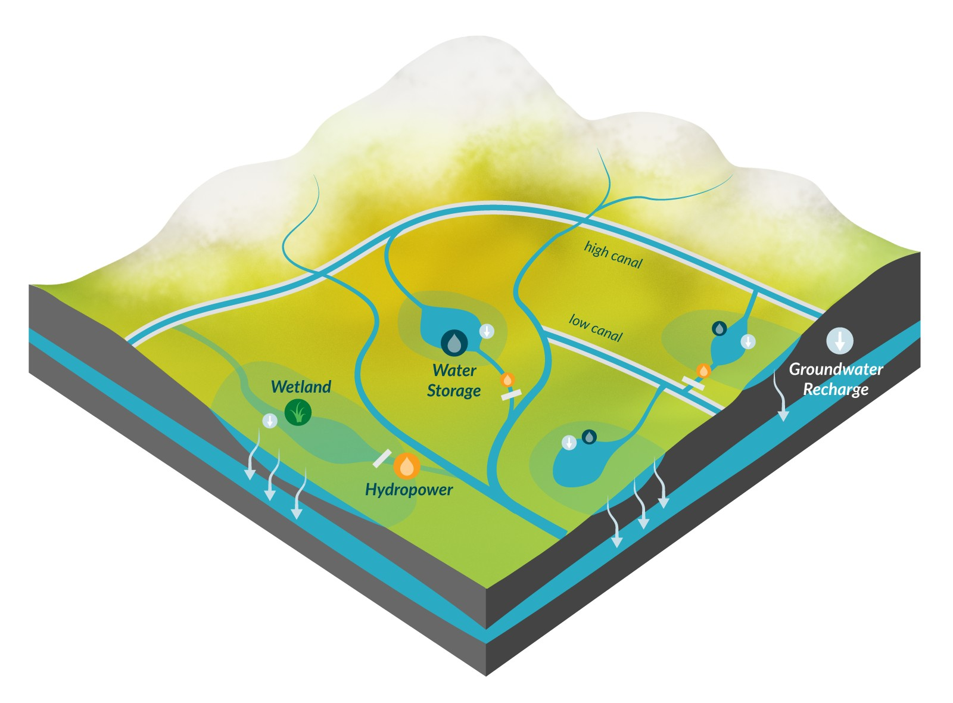
Groundwater Recharge + Power Generation
Natel’s EcoSmartHydro approach, is a solution that can deliver groundwater recharge with the generation of baseload, distributed, renewable energy.
Using Natel’s WatershedOS platform, Natel can systematically design EcoSmartHydro projects that deliver baseload renewable energy, increase groundwater recharge and create opportunities for wetland habitat restoration projects.

Slide 8
In addition, in areas where evaporative loss is a substantial concern, the addition of floating solar could deliver firmed peaking solar power in addition to baseload hydro.

Slide 9
Some numbers:
1.5 million acre-feet of recharge translates to 2,070 cfs of recharge flow for 1 year.
Existing recharge projects in California range between 3 and 30 acres of pond area needed to deliver 1 cfs of recharge.
1.5 million acre-feet of recharge would need 40,000 to 60,000 acres of recharge pond area (California’s land area is
104.8 million acres - we’d need ~0.05%). There are 1.7 million acres of fallow cropland in California this year; 1 million of which are in high priority groundwater zones.
If we assume 50,000 acres of recharge pond area, and assume that we need 10 acres for 1 MW solar, and assume that only 50% of the pond area could be covered, we could build 2.5 GW floating solar on these ponds, which would help minimize evaporative loss, in addition to the generation.
Now, adding hydro, you could generate 1,000 MWh daily dispatchable hydro (assuming 500 MW base capacity, where you operate at a lower capacity factor in off hours, and ramp to full generation for 2 hours each day), if the storage pond was 20 feet deep (assuming the inflow rate to the storage pond was 12,000 cfs (2,000 cfs going into recharge and 10,000 cfs allocated to keep the pond filled up enough for dispatching the hydro).
Finally, moving from thinking about this as one gigantic 50,000 acre pond, and assume that it's distributed in small projects using 2 to 10 hydroEngines each running at 20 feet of gross head, you'd have approximately 100 to 500 projects of 100 to 500 acres each, where each project is generating 1-5 MW hydro, 5-25 MW solar and recharging 4-20 cfs.
Running some quick numbers, this is a $1 billion annual operating profit business with a 20%+ unlevered IRR on a $4 billion investment.

Slide 10
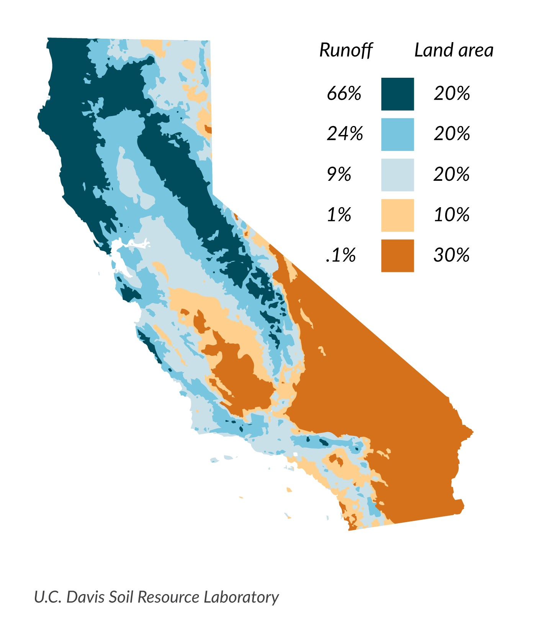
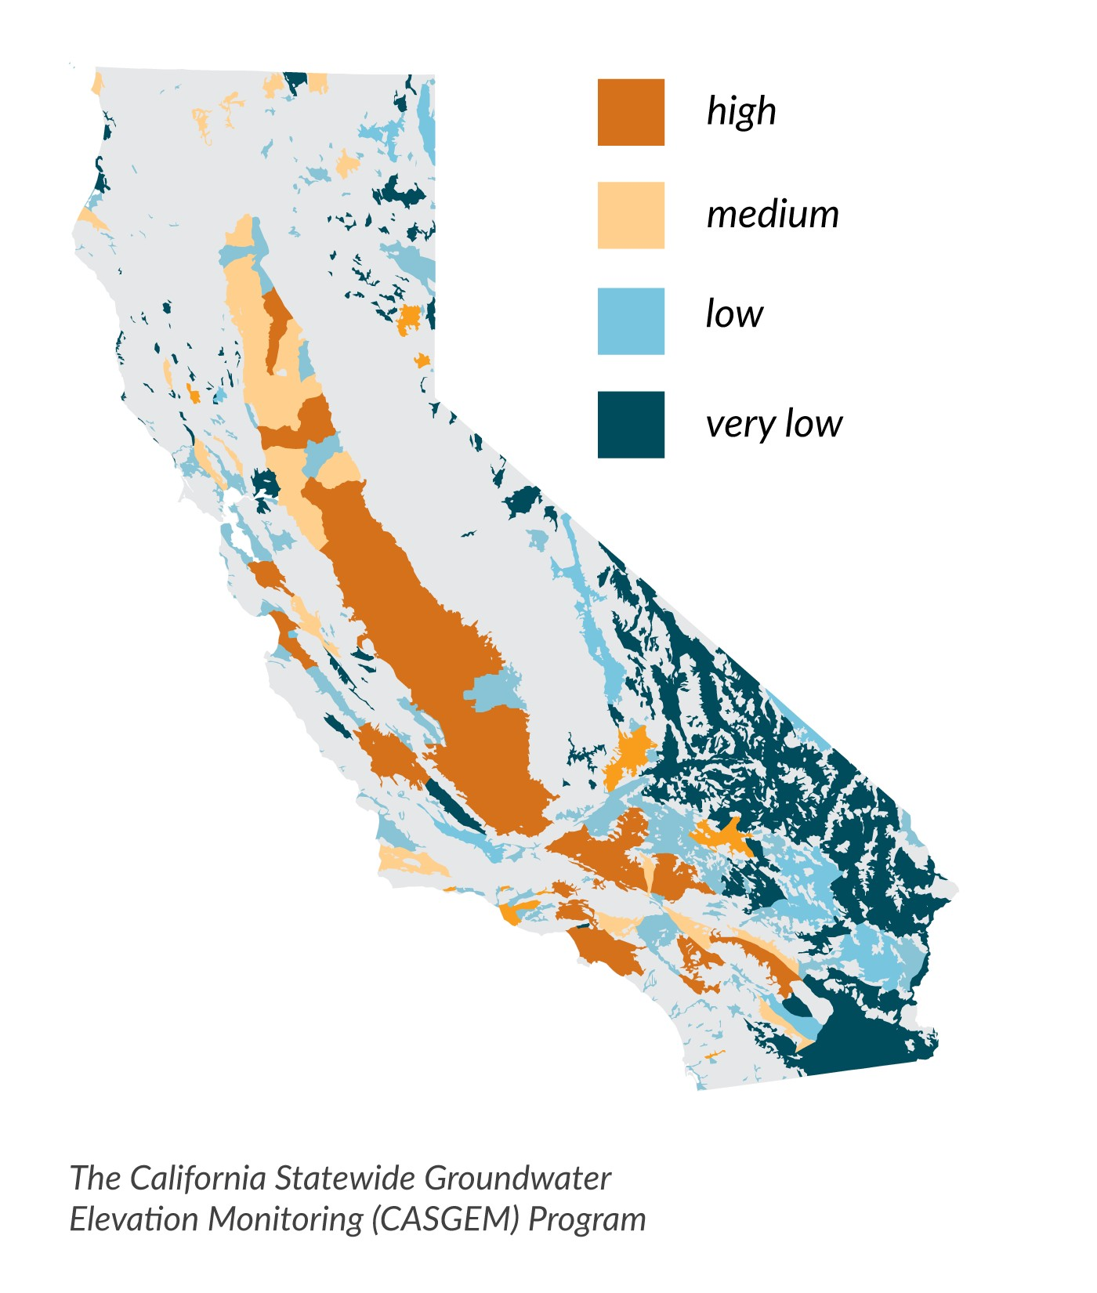
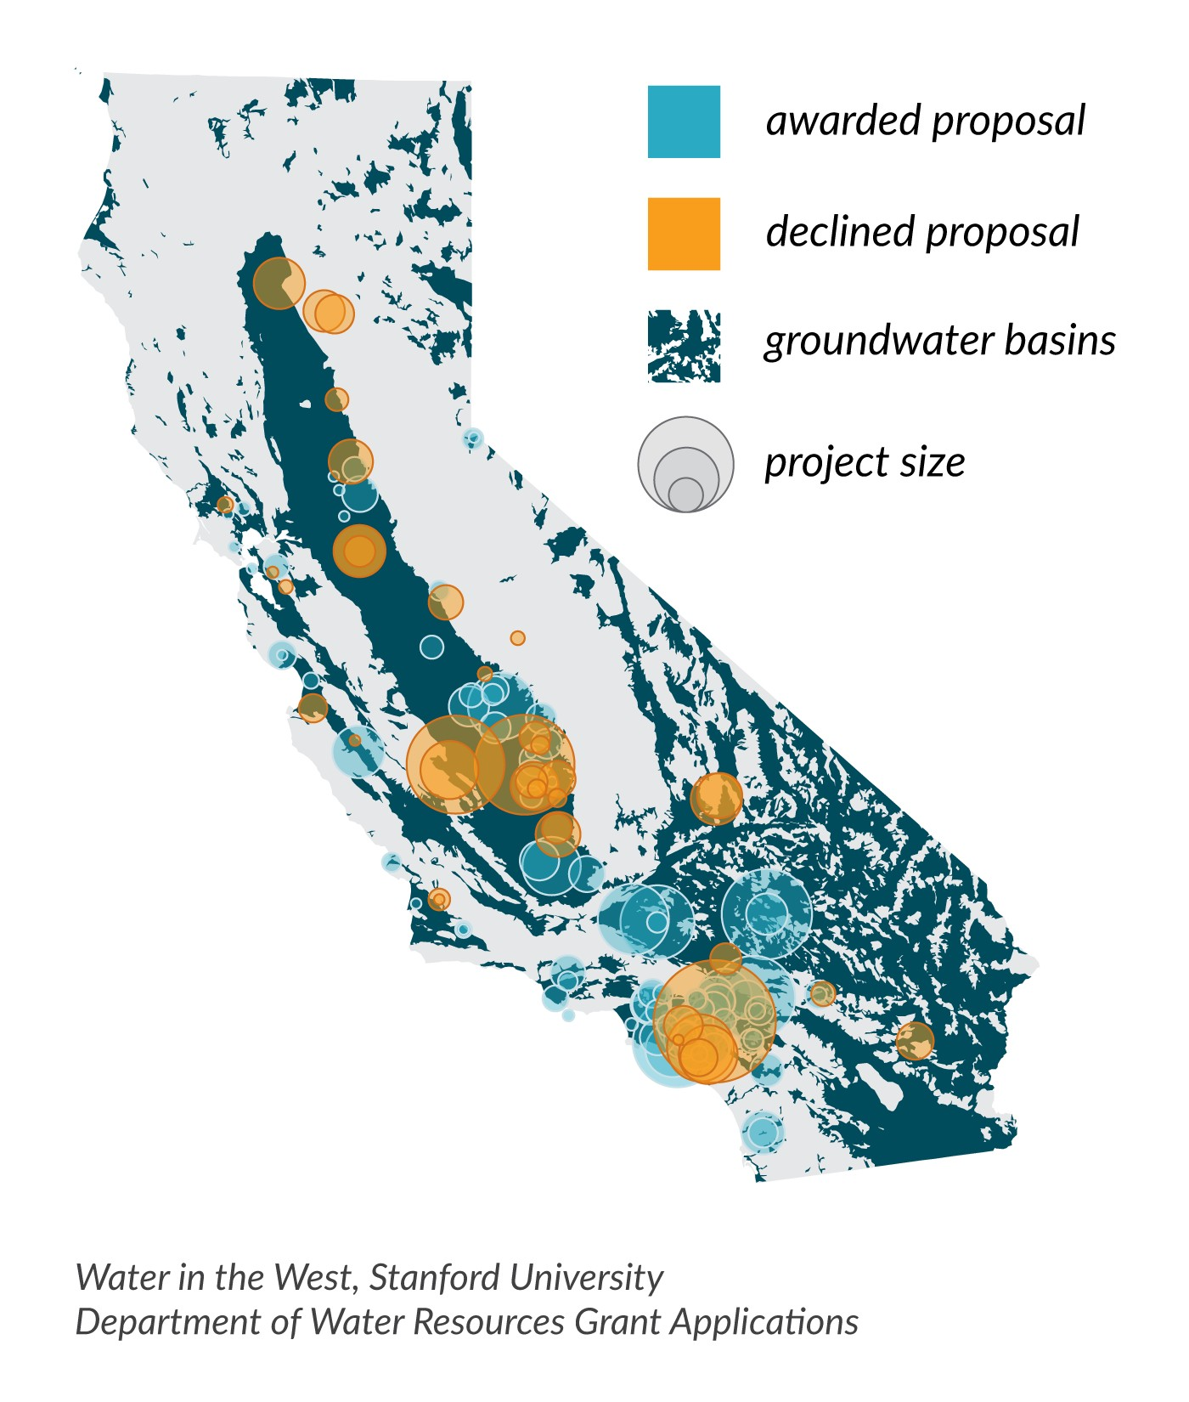
Using WatershedOS, Natel can identify basins with high annual runoff levels, where opportunity exists for improved water capture that can facilitate recharge areas for high priority watersheds, while also harnessing that water flow for energy needs.
Surface Water Runoff
CASGEM Groundwater Basin Prioritization
Groundwater Recharge Project Proposals

Slide 11
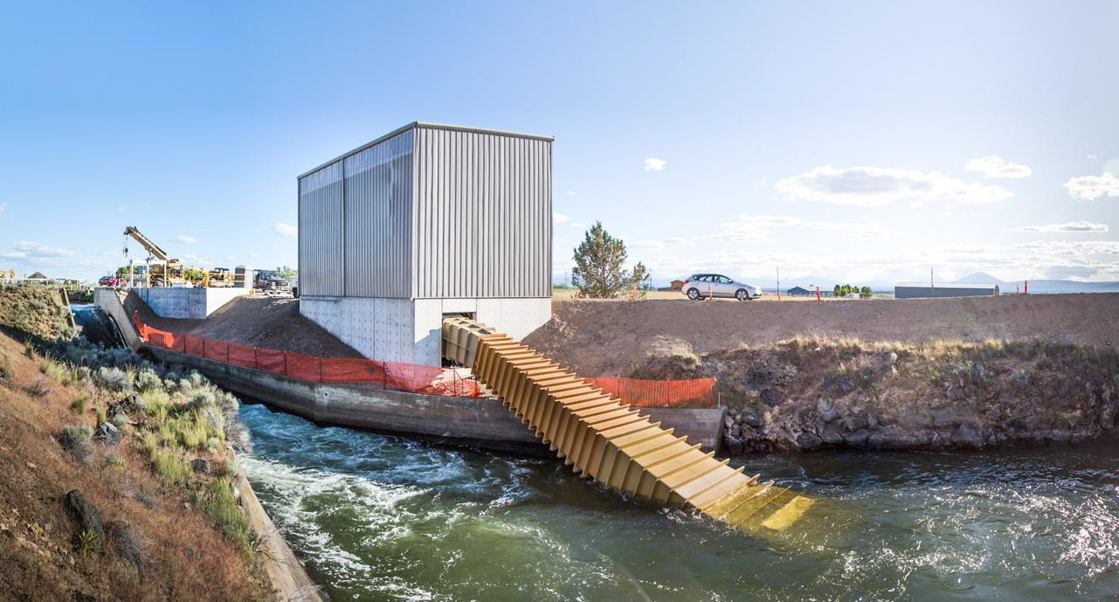

Natel has started building EcoSmartHydro projects in Oregon.
Net Head | 4.8 m (15.8 ft) | Location | Jefferson County, Oregon
Capacity | 300 kW | Customer | Apple Inc.
Flowrate | 10 cms (353 cfs) | Equipment | Natel hydroEngine™
Annual Generation | 1000 MWh | Grid Connected | July 2015
Monroe Hydro Project: 300 kW

Slide 12
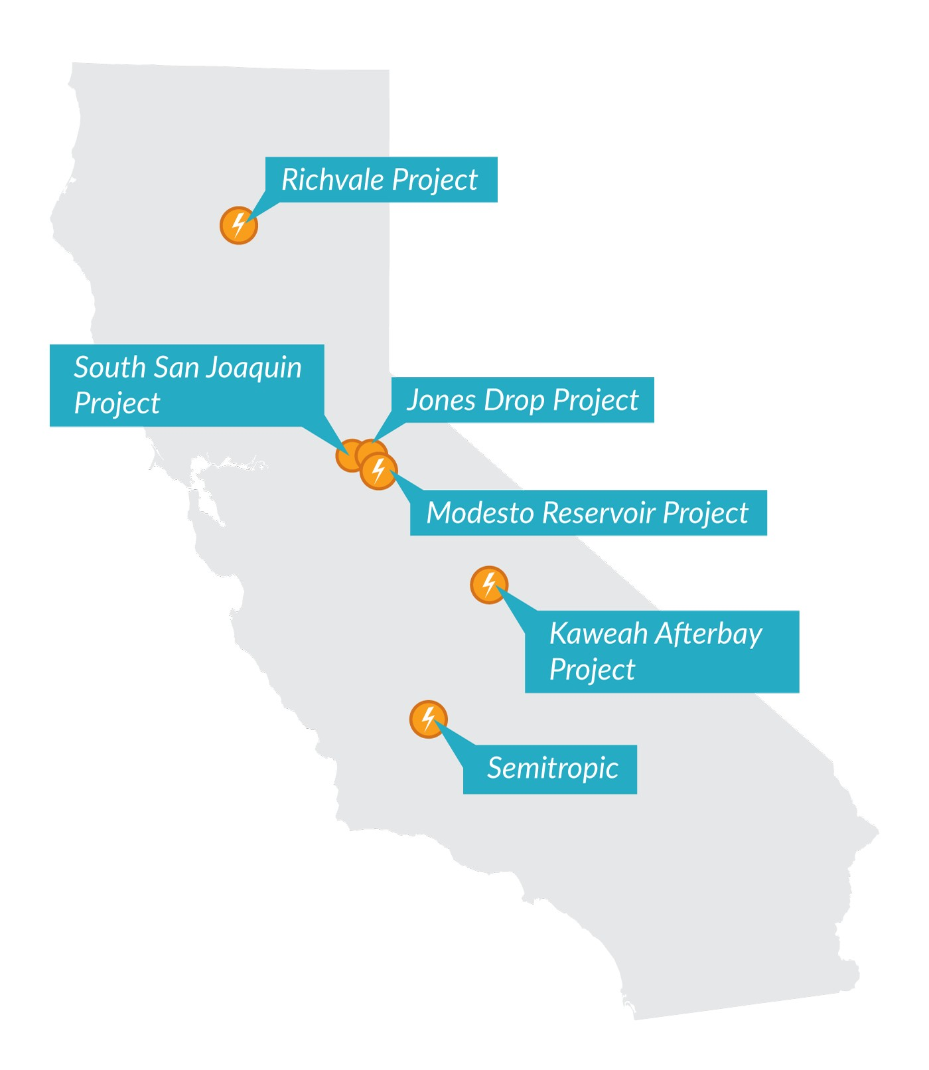
Natel, working with water districts across the state, has already identified potential projects to retrofit existing irrigation structures to produce baseload hydropower.
Project Name | Irrigation District | Expected Annual Generation | Expected Capacity
South San Joaquin Project | South San Joaquin Irrigation District | 1,320 MWhrs | 350 kW
Richvale Project | Richvale Irrigation District | 600 MWhrs | 150 kW
Jones Drop | Modesto Irrigation District | 2,490 MWhrs | 500 kW
Modesto Reservoir | Modesto Irrigation District | 3,100 MWhrs | 600 kW
Kaweah Afterbay | TID & KDWCD | 4,550 MWhrs | 1,200 kW
Semitropic | Semitropic Water Storage District | 1,430 MWhrs | 308 kW

Slide 13
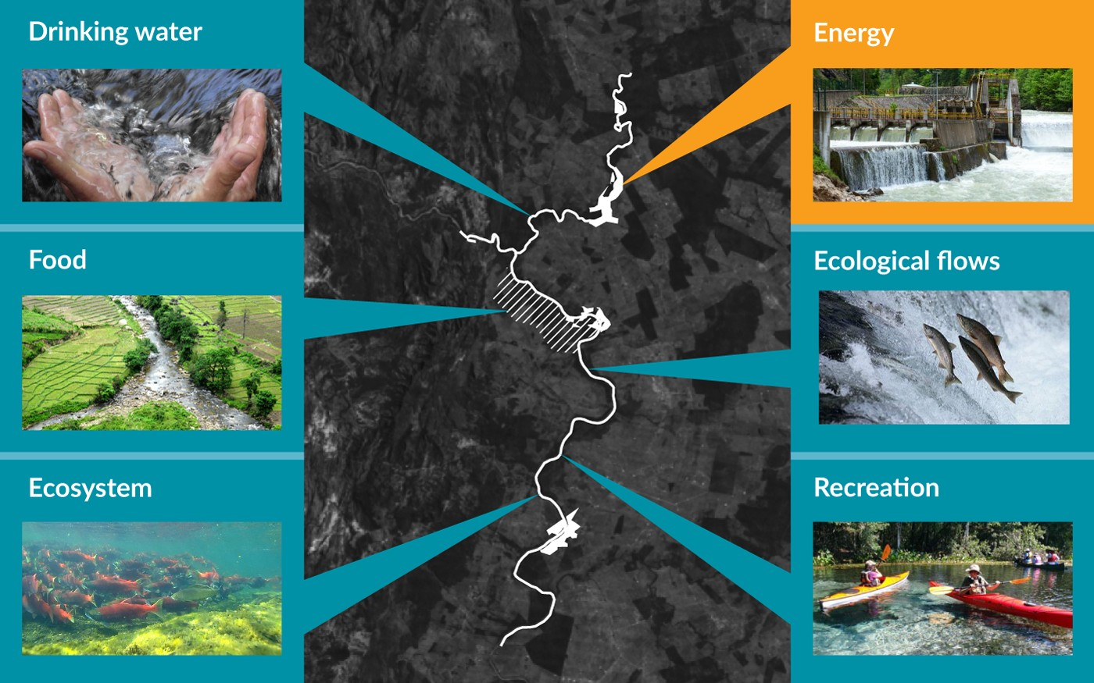
EcoSmartHydro advantages for California:
Increase groundwater recharge while also generating new, baseload, renewable energy
Reduced costs to deliver water + energy value
Retrofit existing irrigation canals to produce new, baseload, renewable energy
Improve runoff management and direct runoff into groundwater storage
Facilitate aquifer recharge for high priority watersheds
Potential to deliver other co-benefits including wetland habitat and sediment management
CONFIDENTIAL, Natel Energy, 2015

Slide 14
Suggestions to unleash the potential of EcoSmartHydro to deliver a combined water+energy solution for California:
Build a knowledge, analytics and monitoring platform to create an interconnected, responsive system that optimizes the natural resource productivity of California’s watersheds to deliver water for energy, water for ecosystems, water for food, water for recreation and water for life: watershedOS.
Provide grant funding to implement pilot EcoSmartHydro projects to validate design (groundwater recharge and electricity), create opportunities for improved watershed monitoring, and provide a better understanding of how this innovative solution can address California’s water crisis.
Design and build projects that increase the efficiency of existing water infrastructure such as irrigation canals, by retrofitting them to produce electricity; and expand water infrastructure where needed.
For additional information, please contact:
Gia Schneider
gia@natelenergy.com
or
Meghan Harwood
meghan@natelenergy.com
CONFIDENTIAL, Natel Energy, 2015

